Slide 1
B460 Height Adjustment Handle Control
October 2023
Intelligent Technologies

Slide 2
B460 Height Adjustment Handle Control
Project Team
ABDULKADİR ERDOĞRU
Business Intelligence Analytic
abdulkadir.erdogru@marturfompak.com
Assistant Manager
OZAN AKYEL
Business Intelligence & S. D.
ozan.akyel@marturfompak.com
Senior Specialist
ERİNÇ EMRE ÇELİKTEN
Business Intelligence & S. D.
emre.celikten@marturfompak.com
Specialist
FURKAN YAKALI
Process Engineering
Specialist
furkan.yakali@marturfompak.com
MURAT BOZ
Corporate Software Development
Specialist
murat.boz2@marturfompak.com
EMRE AKAY
Kocaeli Maintenance
Specialist
emre.akay@marturfompak.com
Notes:
Emre Guren

Slide 3
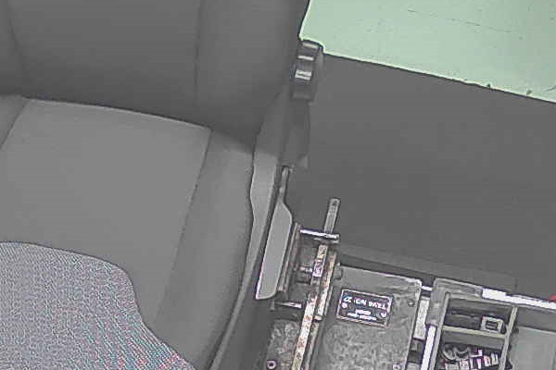
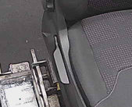
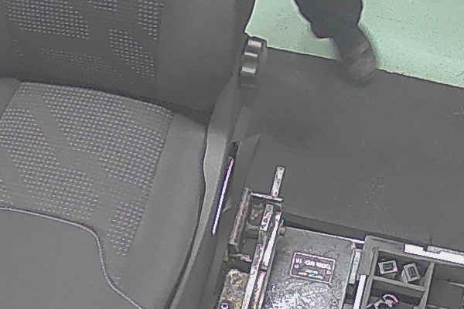
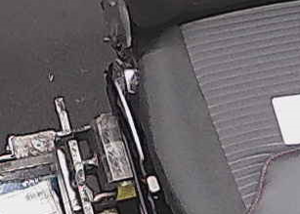
B460 Height Adjustment Handle Control
Project Definition
Proposed Solution
«MFI Custom Vision AI» Image Processing & Development
An artificial intelligence application has been developed that takes a photograph of height adjustment handle part with two 1920*1080px resolution camera and checks absence-presence of the plastic height adjustment handle . In this project, deep learning and image processing techniques are being used, faulty part production was prevented .
First proposed camera : 2 x Dahua Camera
Second proposed camera : Basler Industrial Camera
Development Manpower: 10 person/day
Implementation : The software to be communicated w/ other Line software (I.E. PLC,MES )
Actions: Camera assembling, lightning, cabling
OK
NOK
B460 Height Adjustment Handle Control
Notes:
Emre Guren

Slide 4
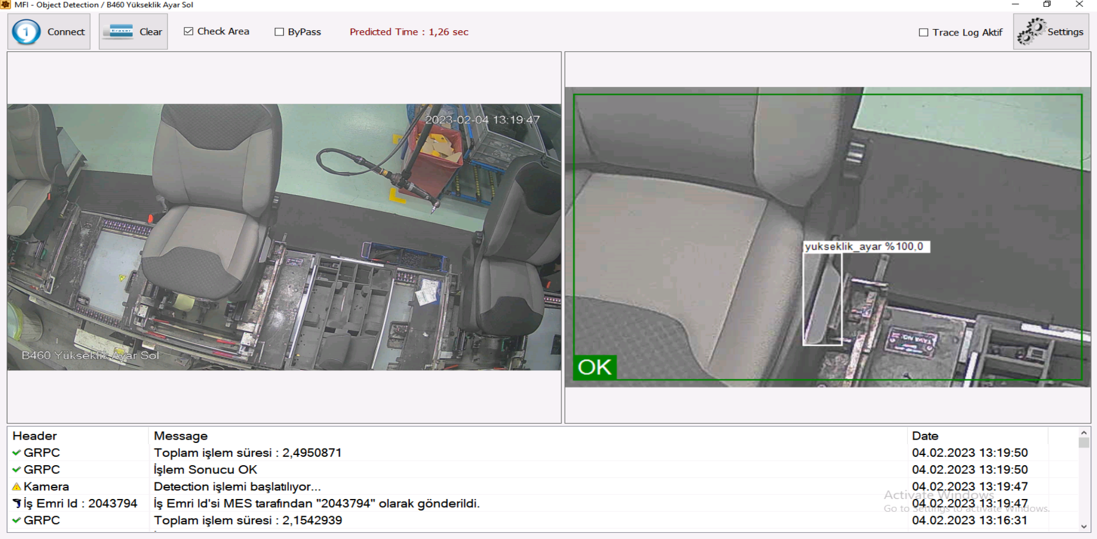
B460 Height Adjustment Handle Control
Solution
Application
Original Image
Predicted Image
Height Adjustment Handle is successfully detected by artificial intelligence application.
Notes:
Emre Guren

Slide 5

THANK YOU…
Notes:
Emre Guren

